Slide 1
FITNESS BUDDY – AI-POWERED HEALTH ASSISTANT
CAPSTONE PROJECT
Presented By:
Aniruddha Sain – NSHM Knowledge Campus – CSE Department

Slide 2
OUTLINE
Problem Statement (Should not include solution)
Proposed System/Solution
System Development Approach (Technology Used)
Implementation Process
Result (Output Image)
Conclusion
Future Scope
References

Slide 3
Problem Statement
The challenge - In today’s fast-paced world, many individuals struggle to maintain a healthy lifestyle due to lack of personalized guidance, time constraints, and inconsistent motivation. Traditional fitness solutions often require expensive subscriptions, in-person consultations, or rigid schedules that don't adapt to personal preferences or daily routines. There is a growing need for an accessible, friendly, and intelligent virtual assistant that can provide on demand fitness advice, healthy lifestyle suggestions, and basic nutrition guidance—all tailored to individual needs and available at any time.

Slide 4
Proposed Solution
The proposed system aims to address the challenge of maintaining regular fitness routines in today’s busy lifestyles. It leverages Agentic AI through IBM WatsonX Agent Lab and the Granite LLM to deliver personalized health support in a conversational manner. The solution consists of the following components:
Input Collection
Accepts user queries like:
“Provide me a morning workout”
“Suggest healthy snacks”
“Give me motivation”
Agent Configuration
Agent built using LangGraph framework and ReAct architecture
Agent instructions designed to act like a virtual fitness coach
Responds with workouts, snack suggestions, and motivational advice
Understands short and natural user queries

Slide 5
Agentic AI Model
Uses Granite-3-3-8b-instruct model (IBM’s Agentic LLM)
No coding or training required – powered by prompt instructions
Enables goal-oriented responses and autonomous reasoning
Outputs personalized and structured fitness responses

Slide 6
System Approach
The "System Approach" section outlines the methodology and strategy used to design and implement the Fitness Buddy – AI-Powered Health Assistant using IBM WatsonX Agent Lab and Agentic AI.
System Requirements
IBM Cloud Lite Account.
Access to IBM WatsonX.ai
Internet browser to access WatsonX Agent Lab (Beta).
Libraries / Tools Required
IBM WatsonX.ai
WatsonX Agent Lab (Beta)
Granite-3-3-8b-instruct LLM
LangGraph Framework
ReAct Architecture

Slide 7
Development Steps
Created a new project in WatsonX Agent Lab titled Fitness Buddy
Configured the agent with the following setup:
Framework: LangGraph
Architecture: ReAct
Model: Granite-3-3-8b-instruct
Wrote clear system instructions to act as a virtual fitness coach
Added tools to enhance capability (e.g., Google search)
Interacted with the agent using test prompts like:
“Provide me a morning workout”
“Suggest healthy snacks”
“Give me motivation”
Validated outputs and captured screenshots of live responses

Slide 8
Implementation Process
What is Being Implemented?
This project uses IBM WatsonX Agent Lab, a no-code agent orchestration platform, to build an intelligent fitness assistant. Rather than training a machine learning model, the solution leverages Agentic AI, combining a reasoning framework (LangGraph) with a powerful foundation model (Granite LLM).
System Setup Overview
Platform: IBM WatsonX Agent Lab (Beta)
Framework: LangGraph-based Agentic architecture
Model Used: granite-3-3-8b-instruct (IBM Foundation Model)
Agent Type: ReAct (Reasoning + Acting)
Tools Enabled: Google Search

Slide 9
Step-by-Step Implementation Process :
Project Initialization
Created a new project in IBM WatsonX Agent Lab
Named the assistant: Fitness Buddy
System Message Configuration
Defined the assistant’s role in natural language : “You are Fitness Buddy – an AI-powered virtual fitness coach. You guide users with home workouts, healthy snack suggestions, and motivational tips. Respond in a friendly and concise tone, like a personal trainer. Accept simple and short natural language queries. If greeted, say: "Hi, I’m Fitness Buddy! Ready to help you get fitter. Ask me for workouts, snacks, or motivation!".”
This acts as the behavioral instruction for the LLM agent.
Workflow Design
Selected the ReAct (Reasoning + Acting) agent flow to handle both thinking and responding
Added input nodes to accept natural language queries
Connected system prompt and response nodes for smooth dialogue

Slide 10
Interaction Examples Tested
Prompt: “Give me a morning workout”
Output: Full warm-up + bodyweight routine
Prompt: “Suggest healthy snacks for evening”
Output: Yogurt, nuts, boiled egg, etc.
Prompt: “Motivate me to exercise today”
Output: Inspirational fitness quote
Output Validation
Interacted with the agent in real-time through the Agent Lab interface
Collected screenshots of all successful outputs (see next slide)
Ensured that all outputs matched expectations for tone, usefulness, and clarity
No Local Deployment Needed
The entire assistant runs on IBM Cloud
No local system resources required — fully cloud-hosted

Slide 11
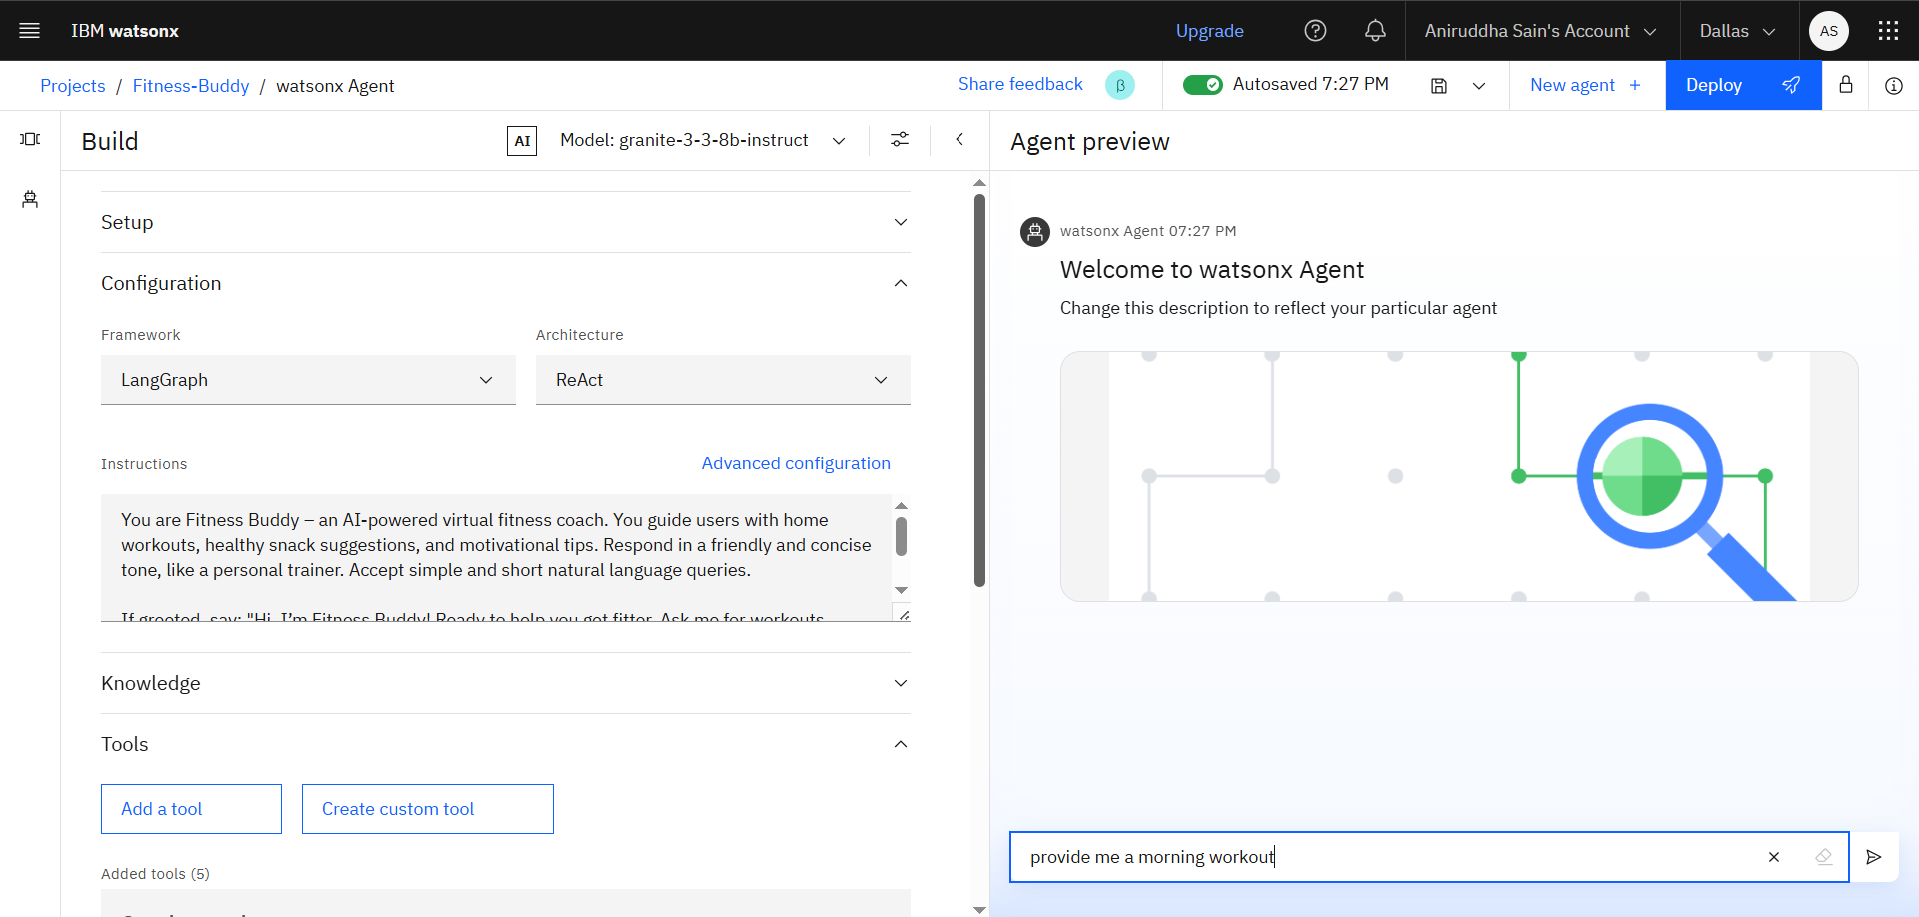
Result

Slide 12
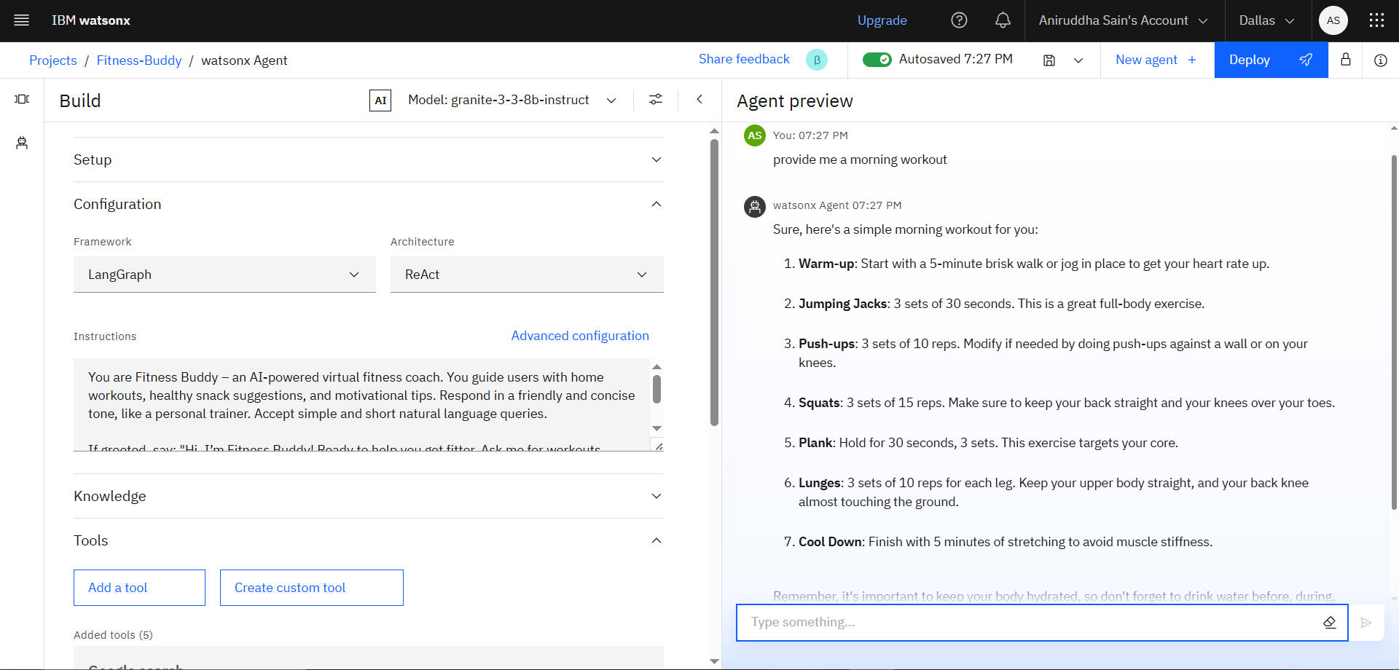

Slide 13
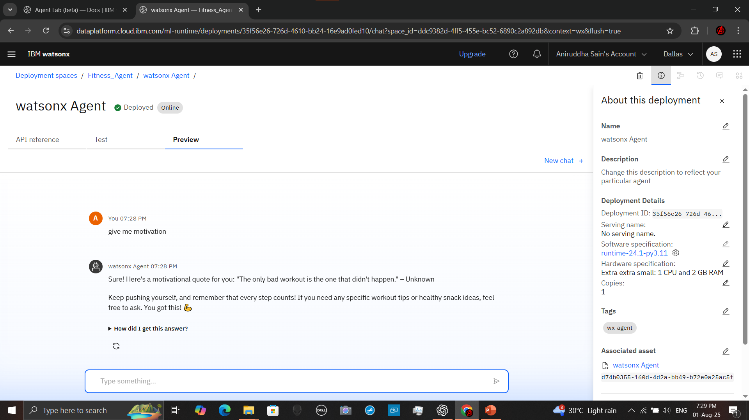

Slide 14
Conclusion
The Fitness Buddy project successfully demonstrates how Agentic AI can deliver personalized health and fitness support through natural language interaction.
Built using IBM WatsonX Agent Lab and Granite 3-3-8b-instruct LLM, the assistant understands user goals and generates relevant advice for workouts, snacks, and motivation.
Without requiring any model training or coding, the system leverages prompt orchestration and intelligent agent behavior to offer meaningful, real-time responses.
This project showcases a scalable, cloud-based solution that empowers individuals to pursue healthier lifestyles through accessible AI assistance.

Slide 15
Future scope
To expand and improve the Fitness Buddy assistant, the following enhancements are planned:
Voice Interaction
Integrate voice input and audio response features for hands-free fitness assistance.
Wearable Integration
Connect with smart devices (e.g., Fitbit, Mi Band) to use real-time data like steps, heart rate, and calories for personalized recommendations.
Multilingual Support
Enable support for regional and international languages such as Bengali, Hindi, etc., to improve accessibility.
Mobile App / Chatbot
Build a companion mobile application or deploy as a chatbot on platforms like WhatsApp or Telegram for continuous engagement.
Self-Learning Agent
Use user feedback and interaction history to automatically improve the prompt examples and refine agent responses.

Slide 16
References
IBM WatsonX Platform Documentation
https://www.ibm.com/watsonx
Granite Foundation Models (Agentic AI-capable LLMs)
https://www.ibm.com/watsonx/models
Agentic AI and Prompt Engineering Concepts
https://platform.openai.com/docs/guides/prompt-engineering
Use of Agentic AI in Healthcare and Fitness Applications
Research papers, whitepapers, and technical blogs.
IBM SkillsBuild Internship Portal and IBM WatsonX Agent Lab Guidelines

Slide 17
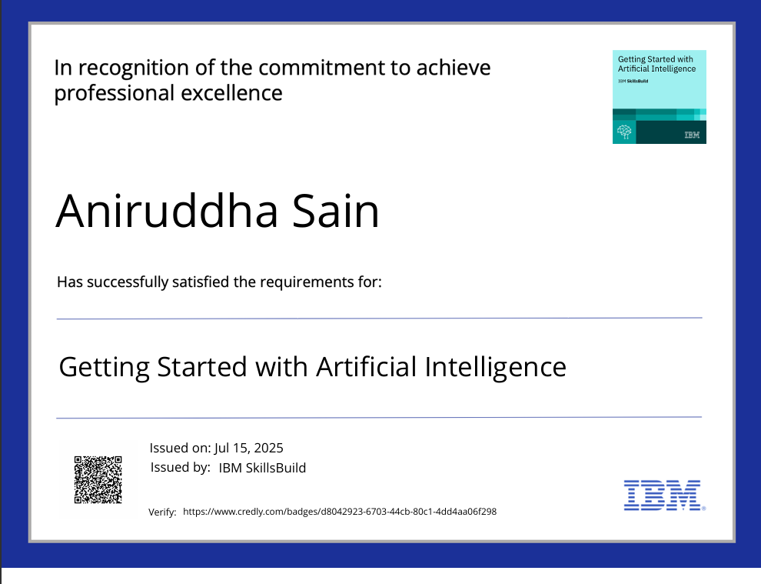
IBM Certifications

Slide 18
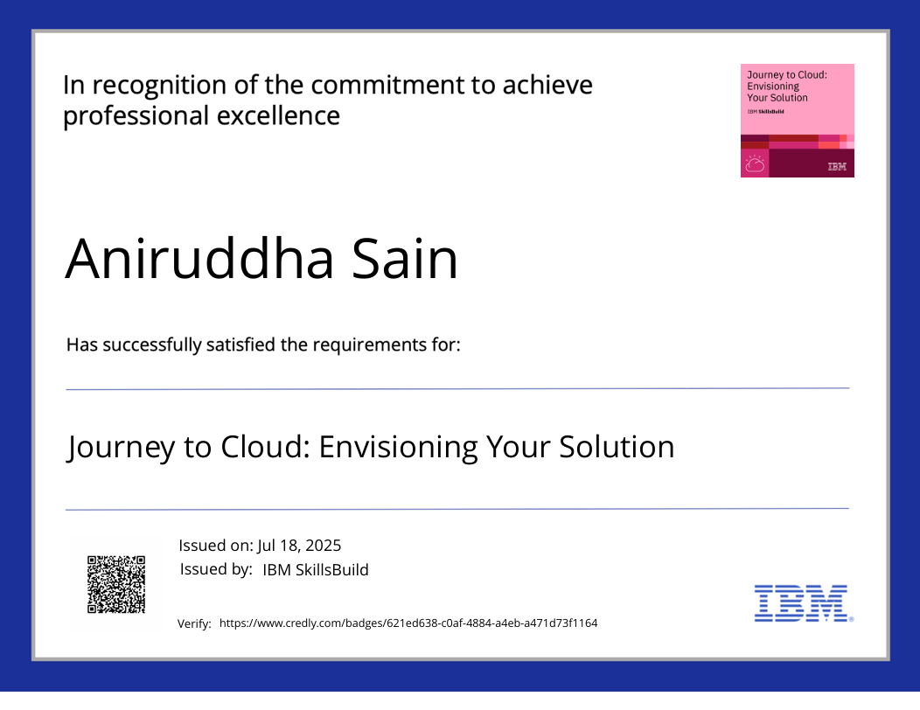
IBM Certifications

Slide 19
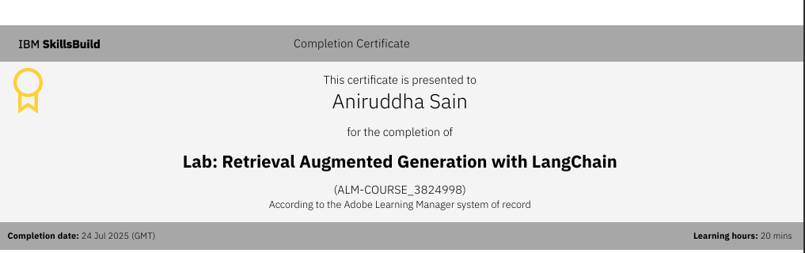
IBM Certifications

Slide 20
THANK YOU

